Slide 1
Design of Digital Filters

Slide 2
Introduction
We studied the theory of discrete systems in both the time and frequency domains. To process signals, we have to design and implement systems called filters (or spectrum analyzers in some contexts).
The filter design issue is influenced by such factors as the type of the filter (i.e., IIR or FIR) or the form of its implementation (structures).
Filter is a generic name that means a linear time-invariant system designed for a specific job of frequency selection. In the context of discrete-time LTI systems, they are called digital filters.
There are two types of digital filters: FIR filter & IIR filter.

Slide 3
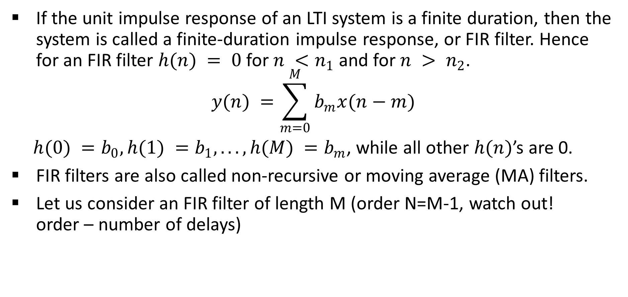
FIR Filters
If the unit impulse response of an LTI system is a finite duration, then the system is called a finite-duration impulse response, or FIR filter. Hence for an FIR filter $h(n) = 0$for $n <n_{1}$ and for $n > n_{2}$.
$$y(n) =\sum_{m=0}^{M}{b_{m}x(n−m)}$$
$h(0) =b_{0}, h(1) =b_{1}, . . . , h(M) =b_{m}$, while all other $h(n)$’s are 0.
FIR filters are also called non-recursive or moving average (MA) filters.
Let us consider an FIR filter of length M (order N=M-1, watch out! order – number of delays)

Slide 4
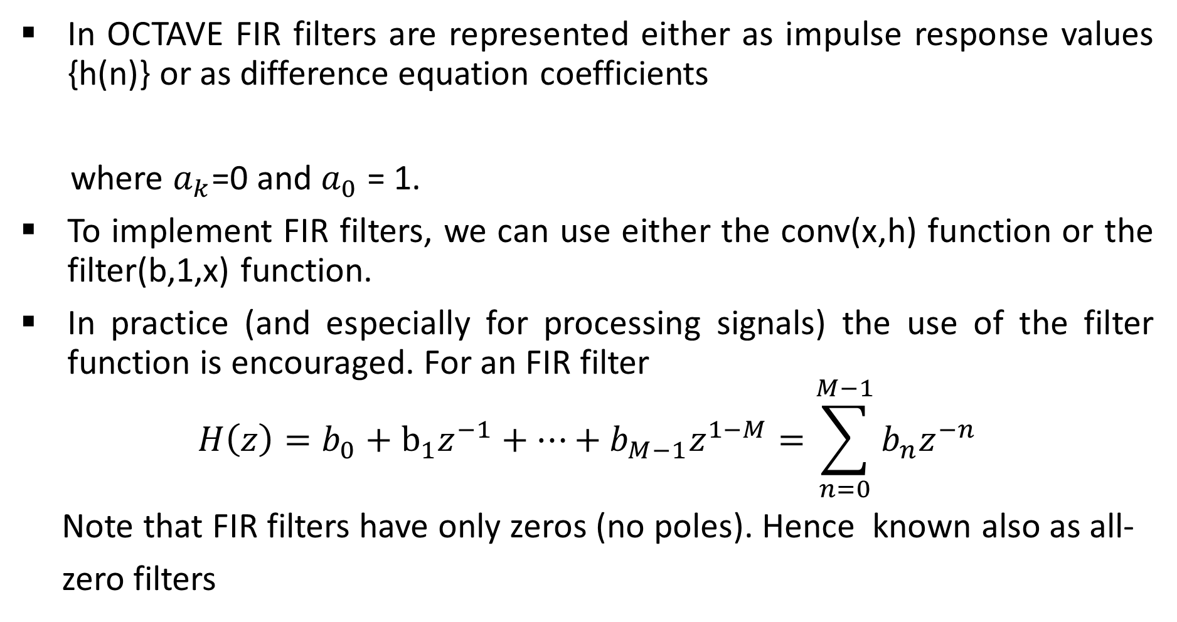
FIR Filters
In OCTAVE FIR filters are represented either as impulse response values {h(n)} or as difference equation coefficients
where $a_{k}$=0 and $a_{0}$ = 1.
To implement FIR filters, we can use either the conv(x,h) function or the filter(b,1,x) function.
In practice (and especially for processing signals) the use of the filter function is encouraged. For an FIR filter
$$H\left(z\right)=b_{0}+b_{1}z^{−1}+…+b_{M−1}z^{1−M}=\sum_{n=0}^{M−1}{b_{n}z^{−n}}$$
Note that FIR filters have only zeros (no poles). Hence known also as all-
zero filters

Slide 5
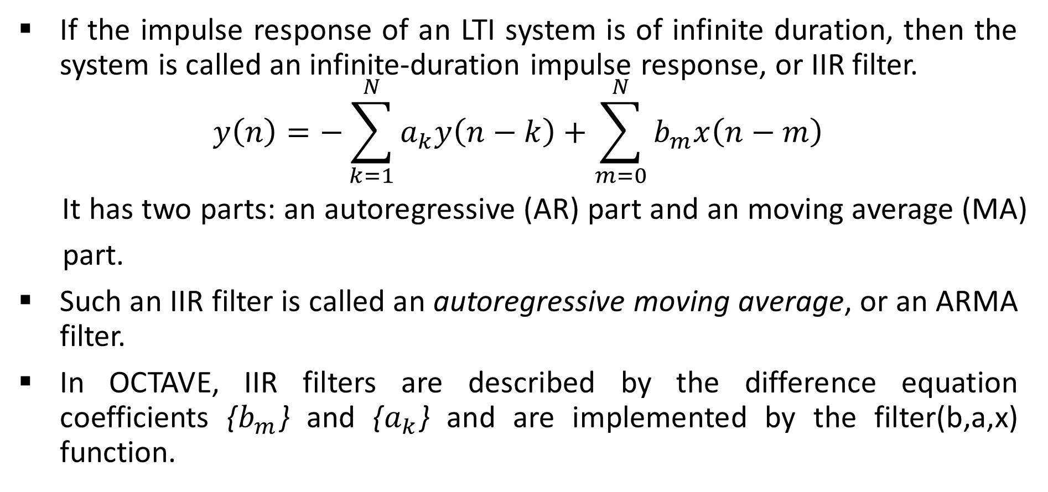
IIR Filters
If the impulse response of an LTI system is of infinite duration, then the system is called an infinite-duration impulse response, or IIR filter.
$$y\left(n\right)=−\sum_{k=1}^{N}{a_{k}y\left(n−k\right)+\sum_{m=0}^{N}{b_{m}x\left(n−m\right)}}$$
It has two parts: an autoregressive (AR) part and an moving average (MA)
part.
Such an IIR filter is called an autoregressive moving average, or an ARMA filter.
In OCTAVE, IIR filters are described by the difference equation coefficients {$b_{m}$} and {$a_{k}$} and are implemented by the filter(b,a,x) function.

Slide 6
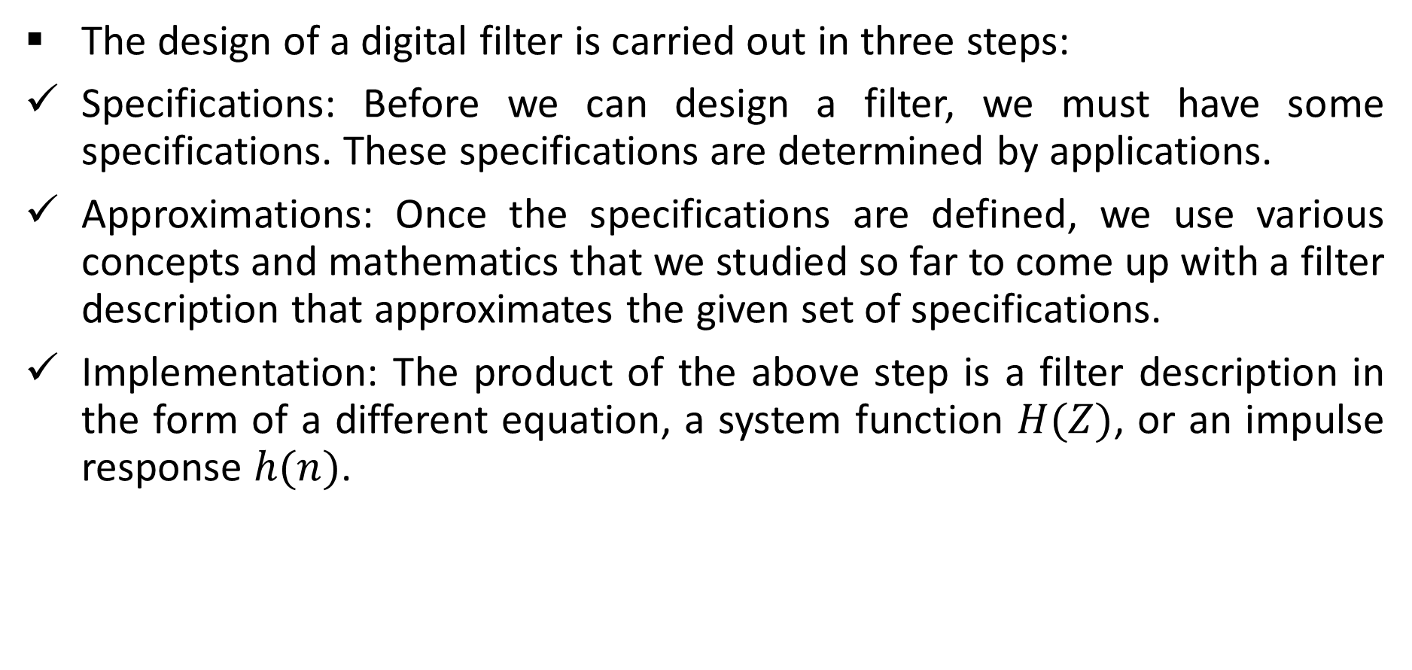
The design of a digital filter: general considerations
The design of a digital filter is carried out in three steps:
Specifications: Before we can design a filter, we must have some specifications. These specifications are determined by applications.
Approximations: Once the specifications are defined, we use various concepts and mathematics that we studied so far to come up with a filter description that approximates the given set of specifications.
Implementation: The product of the above step is a filter description in the form of a different equation, a system function $H(Z)$, or an impulse response $h(n)$.

Slide 7
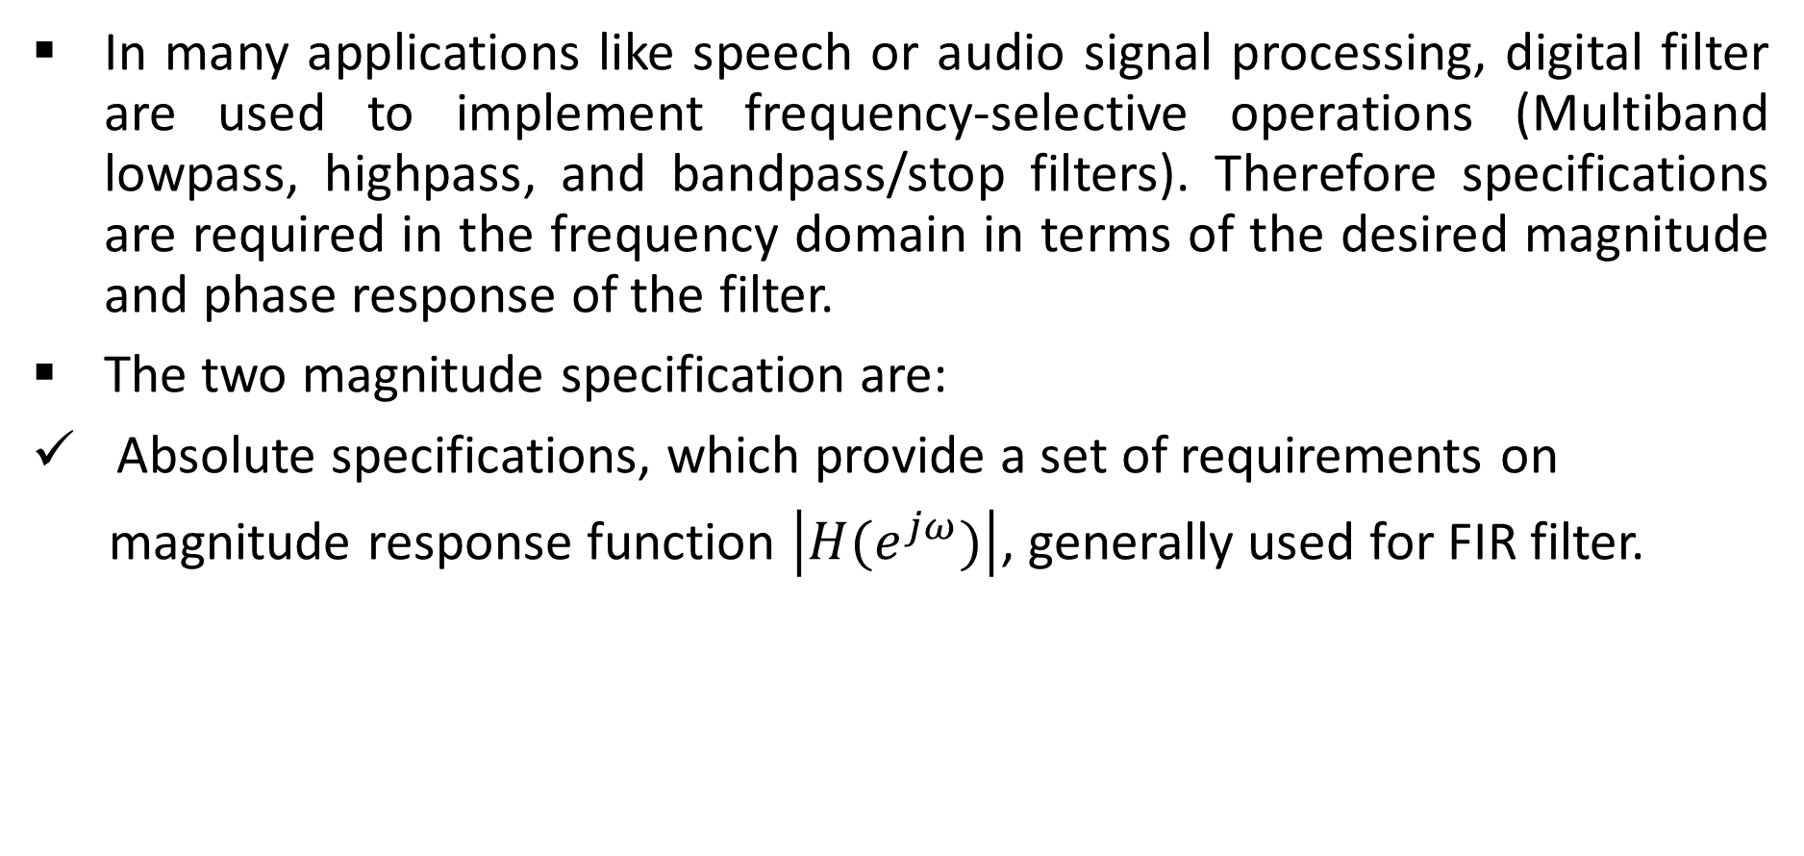
The design of a digital filter: general considerations
In many applications like speech or audio signal processing, digital filter are used to implement frequency-selective operations (Multiband lowpass, highpass, and bandpass/stop filters). Therefore specifications are required in the frequency domain in terms of the desired magnitude and phase response of the filter.
The two magnitude specification are:
Absolute specifications, which provide a set of requirements on
magnitude response function $\left|H(e^{jω})\right|$, generally used for FIR filter.

Slide 8
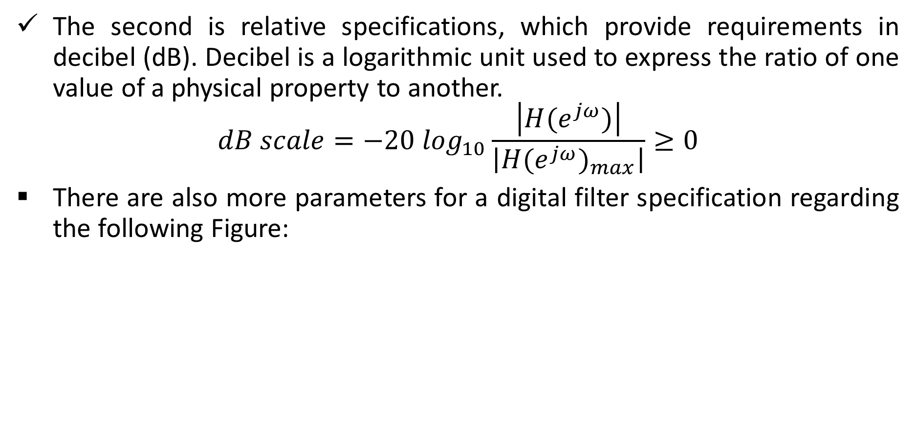
The design of a digital filter: general considerations
The second is relative specifications, which provide requirements in decibel (dB). Decibel is a logarithmic unit used to express the ratio of one value of a physical property to another.
$$dB scale=−20 \log_{10}\frac{\left|H(e^{jω})\right|}{\left|{{H(e}^{jω})}_{max}\right|}≥0$$
There are also more parameters for a digital filter specification regarding the following Figure:

Slide 9
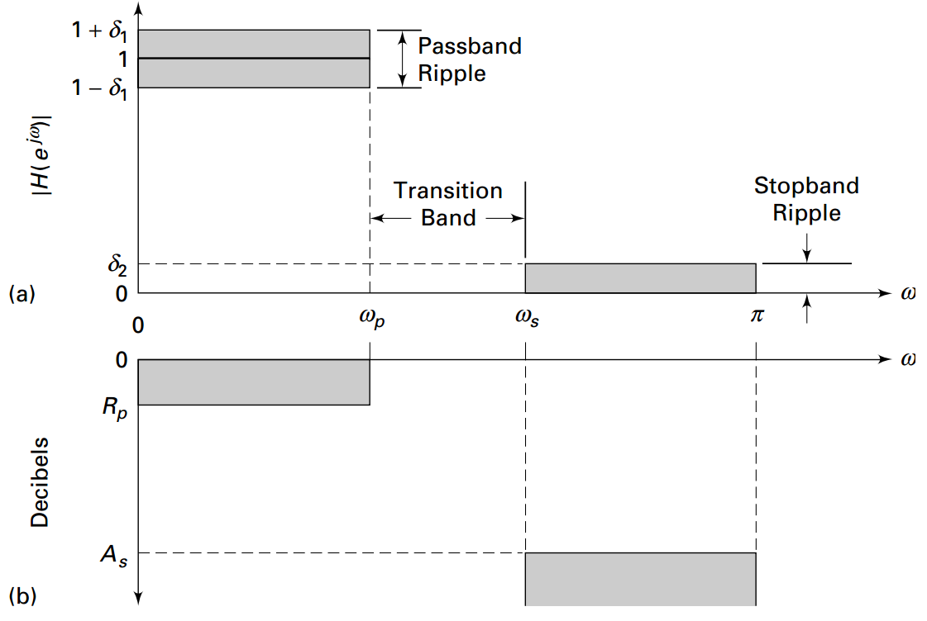
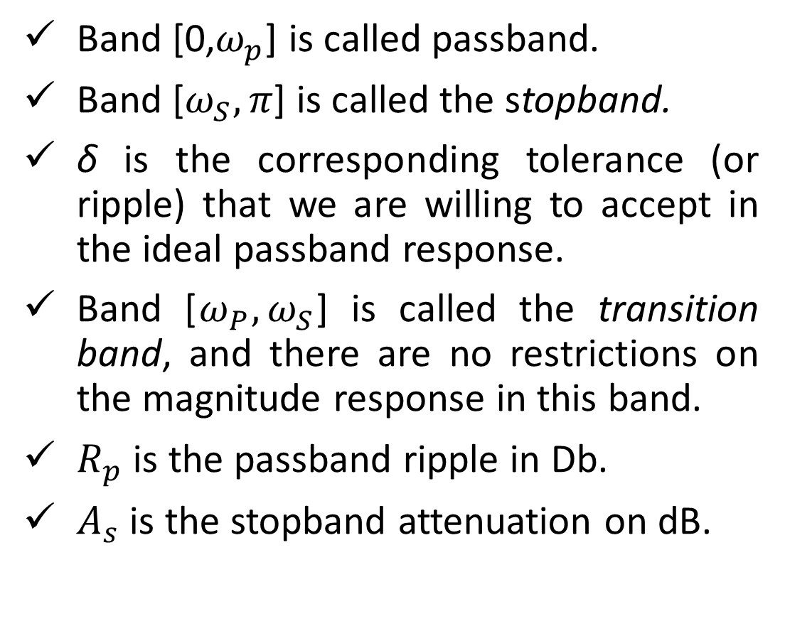
The design of a digital filter: general considerations
Band [0,$ω_{p}$] is called passband.
Band [$ω_{S}, π$] is called the stopband.
δ is the corresponding tolerance (or ripple) that we are willing to accept in the ideal passband response.
Band [$ω_{P}, ω_{S}$] is called the transition band, and there are no restrictions on the magnitude response in this band.
$R_{p}$ is the passband ripple in Db.
$A_{s}$ is the stopband attenuation on dB.

Slide 10
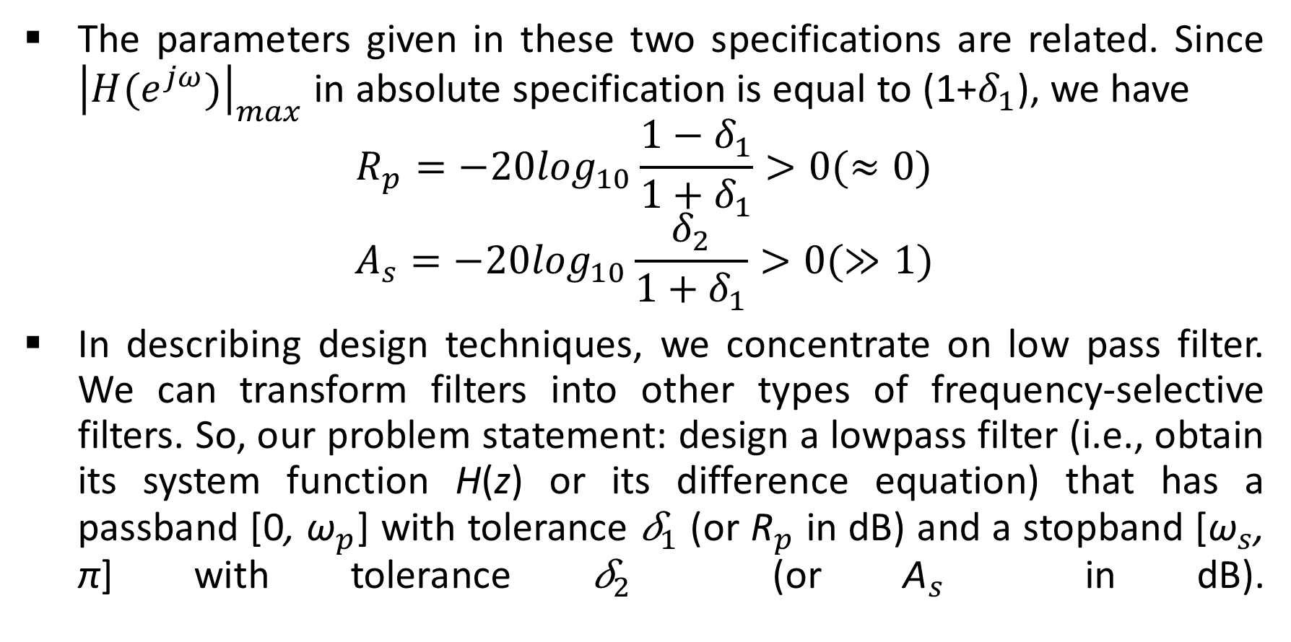
The design of a digital filter: general considerations
The parameters given in these two specifications are related. Since ${\left|H(e^{jω})\right|}_{max}$ in absolute specification is equal to (1+$δ_{1}$), we have
$$R_{p}=−20\log_{10}\frac{1−δ_{1}}{1+δ_{1}}>0(≈0)$$
$$A_{s}=−20\log_{10}\frac{δ_{2}}{1+δ_{1}}>0(≫1)$$
In describing design techniques, we concentrate on low pass filter. We can transform filters into other types of frequency-selective filters. So, our problem statement: design a lowpass filter (i.e., obtain its system function H(z) or its difference equation) that has a passband [0, ${\text{ω}}_{p}$] with tolerance ${\text{δ}}_{1}$ (or ${\text{R}}_{p}$ in dB) and a stopband [${\text{ω}}_{s}$, π] with tolerance ${\text{δ}}_{2}$ (or ${\text{A}}_{s}$ in dB).

Slide 11
Design of a Digital Filter
EXAMPLE In a certain filter’s specifications the passband ripple is 0.25 dB, and the stopband attenuation is 50 dB. Determine δ1 and δ2.
Solution we obtain
Rp = 0.25 = −20 log10 (1 − δ1/1 + δ1)
⇒ δ1 = 0.0144
and
As = 50 = −20 log10 (δ2/1 + δ1)
= −20 log10 (δ2/1 + 0.0144)
⇒ δ2 = 0.0032

Slide 12
Problem statement
Design a lowpass filter (i.e., obtain its system function H(z) or its difference equation) that has a passband [0, ωp] with tolerance δ1 (or Rp in dB) and a stopband [ωs, π] with tolerance δ2 (or As in dB).
These specifications were given for a lowpass filter. Similar specifications can also be given for other types of frequency-selective filters, such as highpass or bandpass.
However, the most important design parameters are frequency-band tolerances (or ripples) and band-edge frequencies. Whether the given band is a passband or a stopband is a relatively minor issue.
In future we will discuss how to transform a lowpass filter into other types of frequency-selective filters.

Slide 13
Problem statement
As we mentioned digital low pass filters might be implemented as FIR filter or IIR filter.
Here, first we turn our attention to the design and approximation of FIR digital filters. These filters have several design and implementational advantages:
The phase response can be exactly linear.
They are relatively easy to design since there are no stability problems.
They are efficient to implement.
The DFT can be used in their implementation.
After reviewing the design techniques for FIR digital filters, we will discuss how to design IIR digital filters.

